Slide 1



Multi Rater Modelling
Meritxell Riera i Marín, PhD candidate

Slide 2
Outline
Motivation
Label fusion techniques
Method wrt Disagreement
Soft vs Hard on Training/Validation
Impact on Calibration
Label Fusion Choice & Takeaways

Slide 3
Outline
Motivation
Label fusion techniques
Method wrt Disagreement
Soft vs Hard on Training/Validation
Impact on Calibration
Label Fusion Choice & Takeaways

Slide 4
Motivation
Data Uncertainty
In Medical Imaging, there is inherent ambiguity in the annotations → aleatoric uncertainty
Interrater Variability
Disagreement is common – ill-defined boundaries (e.g. Tumor margins)
Exploit this variability
Depending on the disagreement, different approaches might be required
Notes:
Medical images -> data uncertainty -> no correct unique label (ambiguous, boundaries blurred) -> aleatoric uncertainty -> inherent to the data itself
Direct consequence -> interrater variability -> if we ask radiologists they Will often disagree (tumor margins, small structures…) -> these are reflextions of the ambiguity in the image & different ways to interpret it -> variability among annotatoris is telling us something relevant & valuable about the data
Rather tan ignoring it we should exploit it -> the level of disagreement can guide how we process the tables and how we train our models -> by aligning our strategy of dealing with multirater annotations to the level of disagreement we can build models + accurate and better calibrated to the real uncertainty
TREATING disagreement as a signal, not a noise

Slide 5
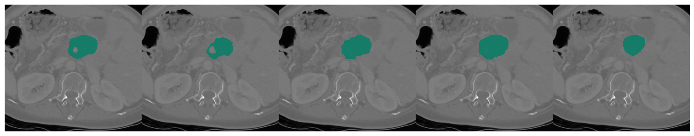
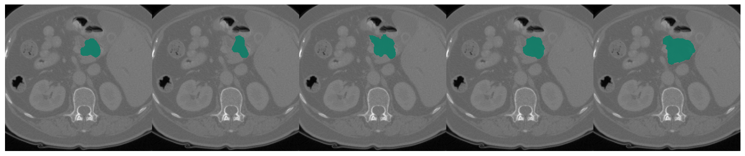

Slide 6
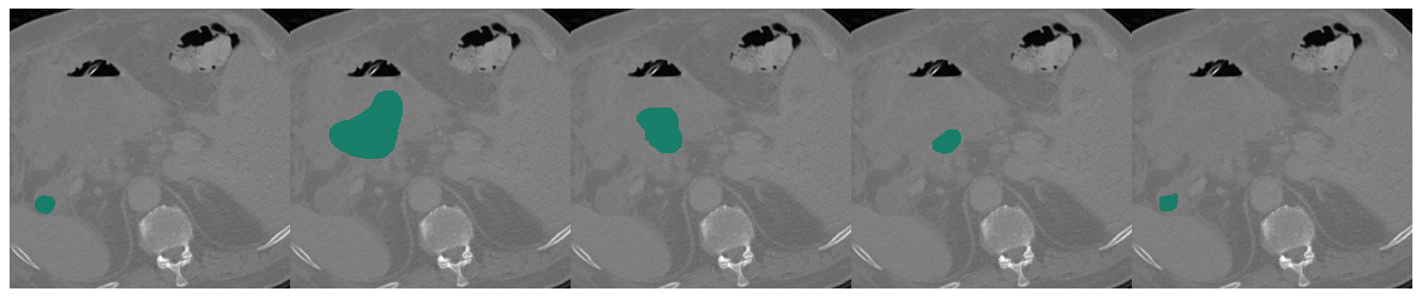


Slide 8
Motivation
Naively choosing one annotation (either raw or created from others) can bias training and evaluation.

Slide 9
Motivation
Naively choosing one annotation (either raw or created from others) can bias training and evaluation.
How do we merge, model or exploit multiple labels?
What is the impact on training and validation?
How does this affect calibration and reliability?

Slide 10
Outline
Motivation
Label fusion techniques
Method wrt Disagreement
Soft vs Hard on Training/Validation
Impact on Calibration
Label Fusion Choice & Takeaways

Slide 11
Label Fusion – Overview
Naive Extremes
Simple Consensus
Random Sampling
Soft Labels
Probabilistic Modeling
(STAPLE)
Other Methods

Slide 12
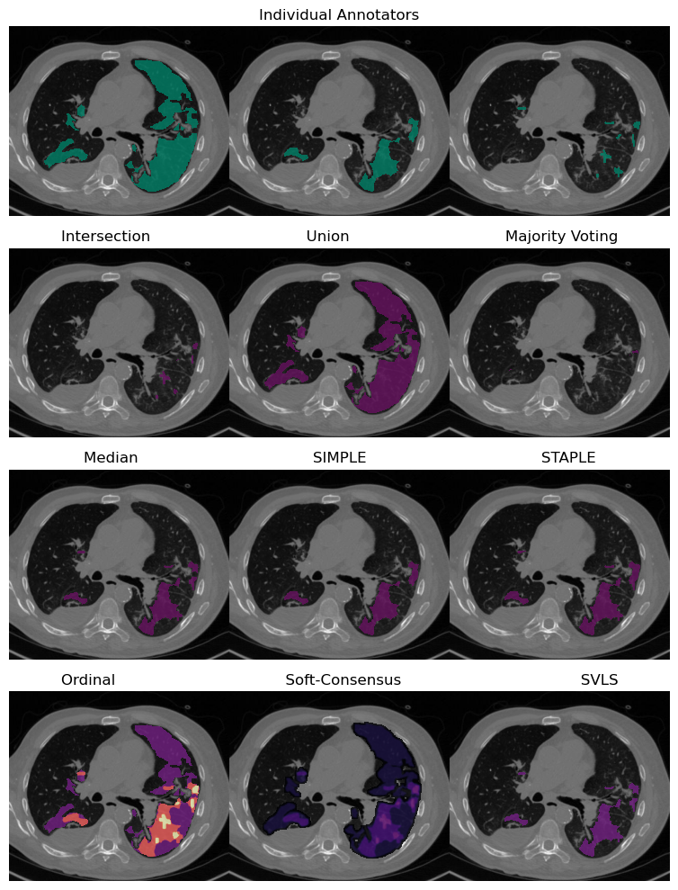



Label Fusion – Naive Extremes
Union, “captures everything”
  High sensitivity, low specificity
  Oversemgent
Intersection, “only agree when sure”
  Low sensitivity, high specificity
  Undersegment
Easy to understand/implement
Oversimplify uncertainty → either too permissive or too conservative
Often used as baselines

Slide 13
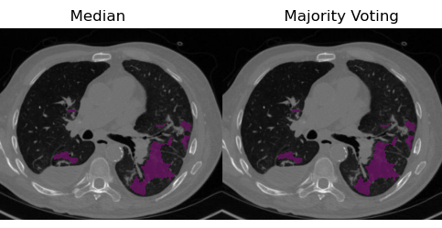
Label Fusion – Simple Consensus
Majority Voting (MV)
Median = MV
  Binary Cases
  Odd number of raters
Robust to outliers
Still a hard label → ignores degree of uncertainty
Weighted voting → acknowledges rater expertise (e.g. juniors versus seniors)
Notes:
Still a hard label → collapses disagreement into binary decision
Advanced version of MV: Weighted voting
Can be data-driven (past accuracy) or expertise-driven
Some raters are more experienced → weight their votes higher
Classification & Segmentation variants exist

Slide 14
Label Fusion – Random Sampling
Instead of collapsing raters → sample one rater’s label at random each epoch/iteration
Preserves diversity across raters
Forces model to “see” all annotation styles over training
Simple, no fusion required
Effective when disagreement is high
Adds variance → requires long training to balance exposure to all raters
Often used as a regularizer → prevents overfitting to a single GT
Notes:
Because you’re introducing randomness into which label is used each time, the effective training target changes from step to step.
This increases the variance of the gradient (your loss surface is noisier), which can slow convergence or make training less stable unless you average over many epochs.

Slide 15
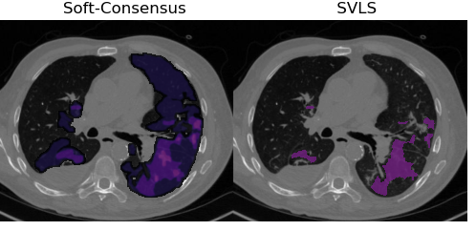
Label Fusion – Soft labels
Soft Consensus: Instead of forcing a hard “truth,” use soft probabilities (fraction of raters agreeing).
Can add spatial smoothing → uncertainty higher near boundaries.
Uncertainty-aware labels
Harder evaluation → soft compatible metrics
Closer to the real distribution of expert uncertainty, can help calibration
Spatially Varying Label Smoothing
Notes:
Soft consensus encodes real-world interrater disagreement, whereas SVLS imposes artificial spatial smoothing to regularize training.

Slide 16

Label Fusion – STAPLE
Initialize: guess true mask
(e.g. Majority voting)
Notes:
1. Initialize: guess true mask (e.g., majority vote).

Slide 17
Label Fusion – STAPLE
Initialize: guess true mask
(e.g. Majority voting)
E-step: given sens/spec, compute probability each voxel is “true” → probabilistic map.
M-step: given current “truth,” update sens/spec for each rater.
Notes:
E-step: Given the current estimates of each annotator’s sensitivity and specificity, compute the probability that each voxel belongs to the true structure (probabilistic “truth” map).
M-step: Given that probabilistic “truth” map, update each annotator’s sensitivity and specificity to best explain their labels.
Iterate: Repeat E and M until convergence; the final probability map is the consensus estimate of the “true” segmentation.
Iterate until convergence.

Slide 18
Label Fusion – STAPLE
Initialize: guess true mask
(e.g. Majority voting)
E-step: given sens/spec, compute probability each voxel is “true” → probabilistic map.
M-step: given current “truth,” update sens/spec for each rater.
When converges
Notes:
“STAPLE alternates between estimating the hidden ‘true’ segmentation and each rater’s reliability, producing a probabilistic consensus map.”

Slide 19
Label Fusion – STAPLE
Simultaneous Truth And Performance Level Estimation (STAPLE)
Learns both a latent “true mask” and rater reliabilities
Accounts for individual rater reliability
Assume independence, voxel-wise independence may break for segmentation
Acknowledge raters are noisy observers

Slide 20
Label Fusion – Other Methods
DL-based label fusion: CNNs that learn to combine rater maps into consensus
  Small network learns to fuse multi-rater inputs into a consensus map
Multi-Annotator Training – e.g. loss functions that compare predictions to all raters instead of a fused mask
Bayesian / Uncertainty-Aware Networks – explicitly predict per-voxel uncertainty calibrated to rater disagreement.
Can incorporate spatial context & rater-specific patterns
Directly train model with uncertainty included
Require more data and careful design → harder to interpret and validate than classical methods
These are more flexible but less standardized → ongoing research

Slide 21
Outline
Motivation
Label fusion techniques
Method wrt Disagreement
Soft vs Hard on Training/Validation
Impact on Calibration
Label Fusion Choice & Takeaways

Slide 22
Method wrt Disagreement
Method | Low disagreement (raters mostly agree) | High disagreement (raters split)
Union | ≈ Majority/Intersection → stable | Over-segmented, very sensitive
Intersection | ≈ Majority → stable | Under-segmented, overly strict
Majority Voting | Stable, near ground truth | Hides minority opinions → biased
Random Sampling | ≈ Majority → stable | Preserves diversity, robust
STAPLE | Works well → estimates reliabilities | Still OK, but limited by independence assumption
Soft Labels | Almost same as hard mask | Best at reflecting real uncertainty
When disagreement is low → all methods converge, choice doesn’t matter much.
When disagreement is high → choice of fusion method critically changes the “truth” the model learns.
Notes:
When raters largely agree, simple fusion methods like majority voting may be sufficient. But when disagreement is high, we may need more sophisticated approaches — probabilistic models, soft labels, or even training strategies that directly model each annotator.
BUT when disagreement is high, the choice is critical since completely the opposite happens
Using union or intersection as a baseline might be correct but never train an actual model that you want it to work with this naïve extremes -> will end up over or under segmenting

Slide 23
Outline
Motivation
Label fusion techniques
Method wrt Disagreement
Soft vs Hard on Training/Validation
Impact on Calibration
Label Fusion Choice & Takeaways

Slide 24
Soft vs Hard on Training/Validation
 |  |  | Hard Labels | Soft Labels
Training |  |  | • Faster convergence • Clear GT target • Simple loss functions (cross-entropy, Dice) | • Let the model learn uncertainty and variability • Reduces overconfidence → lead to better calibration • Can improve generalization in ambiguous regions
 |  |  | • Forces model to treat all disagreements as certain • Overconfidence / poor calibration • Can overfit to arbitrary consensus → implicitly assume certainty in one GT | • Loss functions compatible with continuous labels • Slower convergence if uncertainty high • Choice of smoothing parameters matters
Validation |  |  | • Easy evaluation metrics (Dice, IoU) • Easier interpretability by clinicians | • Can compare model probabilities directly to rater agreement • Better reflection of inherent ambiguity
 |  |  | • Metrics hide uncertainty (single number) • Apparent performance depends strongly on fusion method | • Harder to benchmark with standard metrics • Need thresholding or probabilistic metrics • May show lower peak Dice even if better calibrated
Best Use Case |  |  | Low disagreement or when binary GT is required for deployment. | High disagreement or when uncertainty estimation / calibration is critical.
Notes:
Overall, calibration benefits most from soft labels/random sampling in high-disagreement cases.

Slide 25
Outline
Motivation
Label fusion techniques
Method wrt Disagreement
Impact on model Training and Validation
Impact on Calibration
Label Fusion Choice & Takeaways

Slide 26




Impact on Calibration
Fusion Choice
Training Target
Model Confidence
Calibration Quality

Slide 27
Impact on Calibration
Hard Labels:
Treat all voxels as certain
Model tens to become overconfident in ambiguous areas
Calibration curves show underestimation of uncertainty
Soft Labels:
Encode rater disagreement in the target
Encourage model to predict probabilities matching rater agreement → real uncertainty
Lead to improved Expected Calibration Error
Fusion Choice
Label fusion isn’t just preprocessing — it defines the (probability) target your model learns, which directly shapes calibration.
Notes:
Label fusion isn’t just preprocessing — it defines the probability target your model learns, which directly shapes calibration.

Slide 28
Outline
Motivation
Label fusion techniques
Method wrt Disagreement
Soft vs Hard on Training/Validation
Impact on Calibration
Label Fusion Choice & Takeaways

Slide 29
Label Fusion Choice
 | Why It Matters | Examples
Level of Disagreement | High disagreement → need richer models (STAPLE, soft labels) Low disagreement → simple consensus often sufficient. | Tumor margins vs. well-defined organs
Computational Resources & Time | Some methods (STAPLE, Bayesian models) require EM iterations or MCMC, can be slow for 3D volumes. Simple majority/union is fast. | Large CT volumes with many raters
Goal of the Model | If the model’s main output is binary masks for deployment, simple fusion may suffice. If you need calibrated probabilities/uncertainty, prefer soft/probabilistic methods. | Clinical decision support vs. research prototype or other research fields
Complexity of the Problem | More complex anatomical regions or subtle findings → benefit from probabilistic/soft approaches. Well-defined, high-contrast structures → simpler methods. | Pancreatic tumor vs. lung parenchyma segmentation
Data Size & Number of Raters | Fewer raters → probabilistic methods may be less stable. More raters → benefits grow. | Small expert panel vs. crowdsourced annotations
Notes:
The choice of fusion model isn’t only about accuracy or theory. It’s also shaped by practical constraints — how much data you have, how much time you can spend computing, and what your ultimate goal is.
For example, if you’re working with a large dataset of clear structures and you just need a binary mask quickly, majority voting or union may be perfectly fine. But if you’re dealing with subtle, ill-defined boundaries and you care about calibrated confidence, it’s worth investing the time in a probabilistic or soft-label approach.
In short, there’s no single ‘best’ fusion method — the optimal choice depends on disagreement level, computational resources, and the intended use of the model.

Slide 30
Label Fusion Choice & Takeaways
Interrater variability is a valuable signal, not just noise — it reflects real uncertainty in medical imaging. This uncertainty should be reflected in the predictions as well.
Different label fusion methods offer trade-offs in simplicity, computational cost, and ability to model uncertainty.
Fusion choices directly shape model training targets and strongly influence calibration, confidence, and clinical reliability.
Choosing the right fusion strategy depends on disagreement level, computational resources, and the intended goal of the model — and this variability should be addressed not only during training but also in evaluation.
  See spotlight presentation.

Slide 31
Thank you
Meritxell Riera i Marín, PhD candidate
m.riera@sycaitechnologies.com

